Slide 1
Machine Learning Lab
7A,B,C

Slide 2
Program 1
Implement and demonstrate the FIND-S algorithm for finding the most specific hypothesis based on a given set of training data samples. Read the training data from a .CSV file.
sky, airtemp, humidity, wind, water, forecast, enjoy sport
Sunny, Warm, Normal, Strong, Warm, Same, Yes
Sunny, Warm, High, Strong, Warm, Same, Yes
Rainy, Cold, High, Strong, Warm, Change, No
Sunny, Warm, High, Strong, Cool, Change, Yes

Slide 3
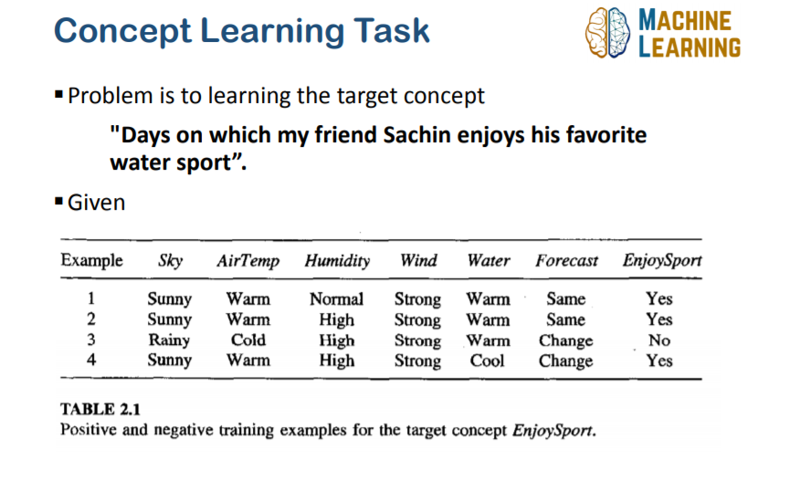
Concept Learning

Slide 4
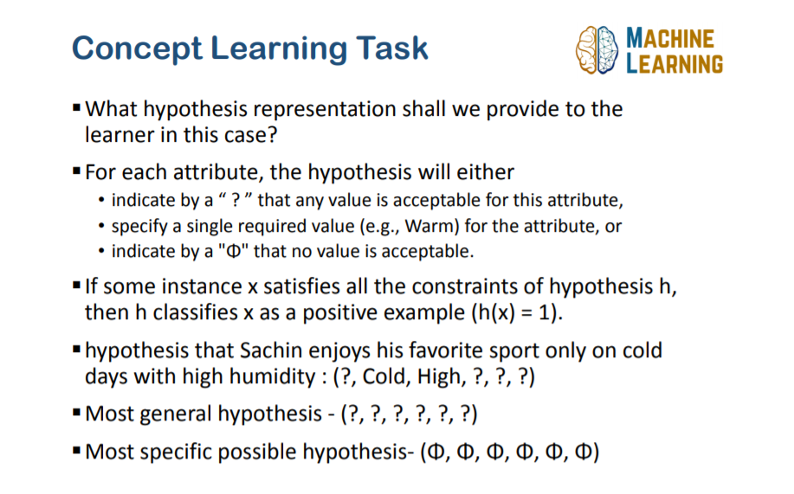

Slide 5
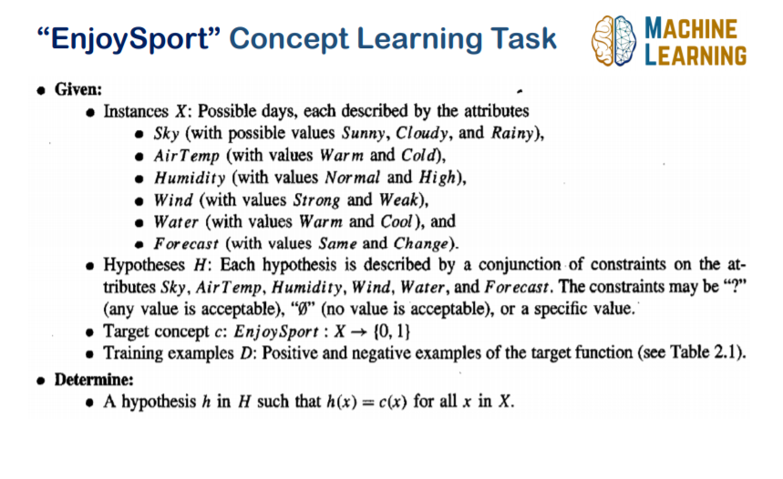
Example

Slide 6
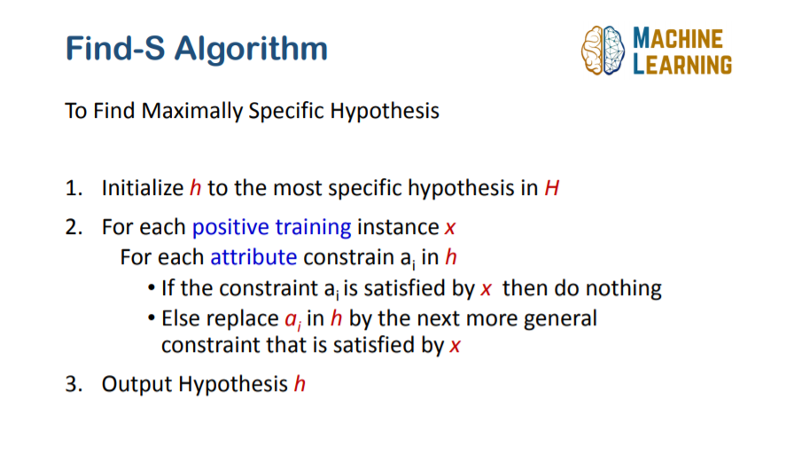

Slide 7
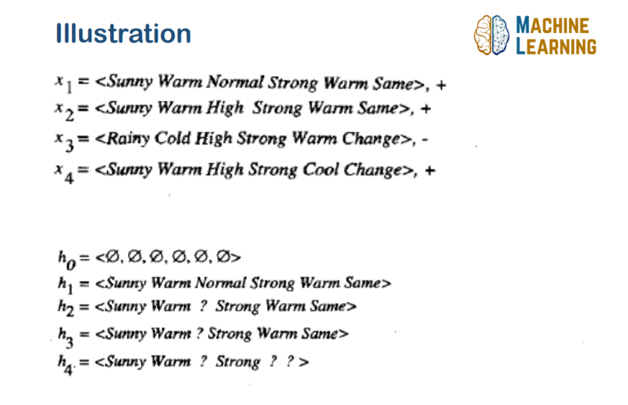

Slide 8
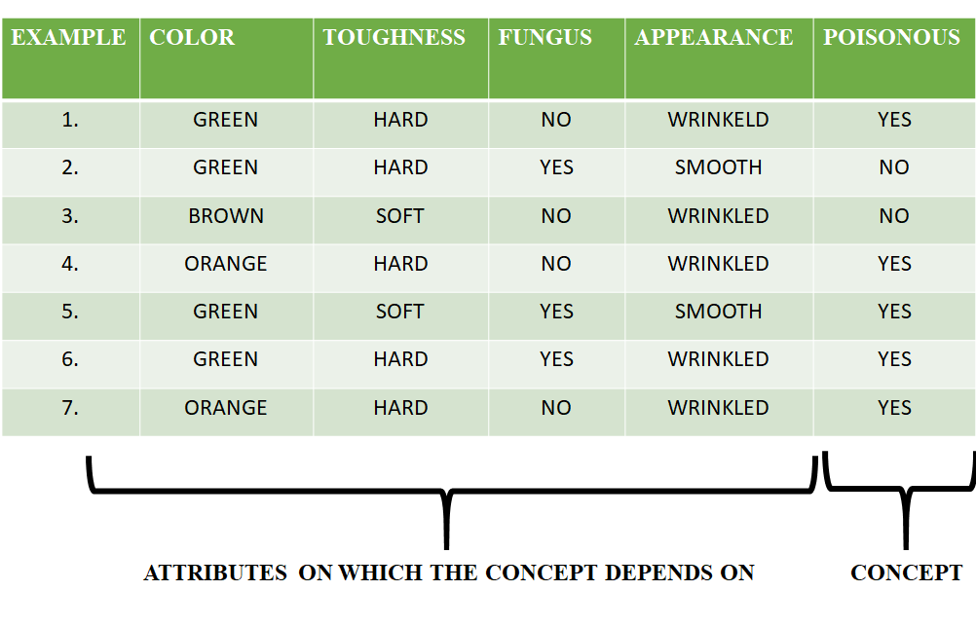
Try!! Consider the following data set having the data about which particular seeds are poisonous

Slide 9
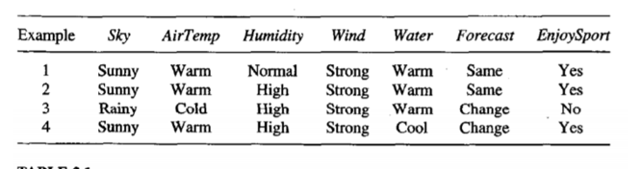
Program 2
For a given set of training data examples stored in a .CSV file, implement and demonstrate the Candidate-Elimination algorithm to output a description of the set of all hypotheses consistent with the training examples.
.

Slide 10
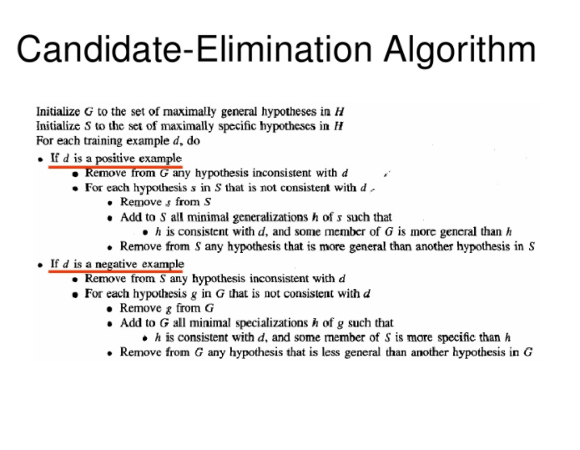
CANDIDATE ELIMINATION ALGORITHM The candidate-Elimination algorithm computes the version space containing all (and only those) hypotheses from H that are consistent with an observed sequence of training examples

Slide 11
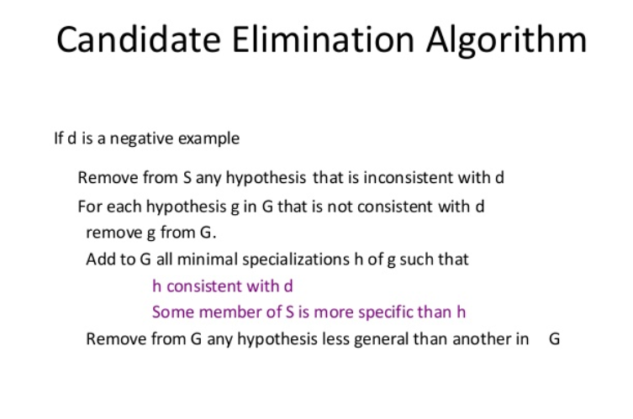

Slide 12
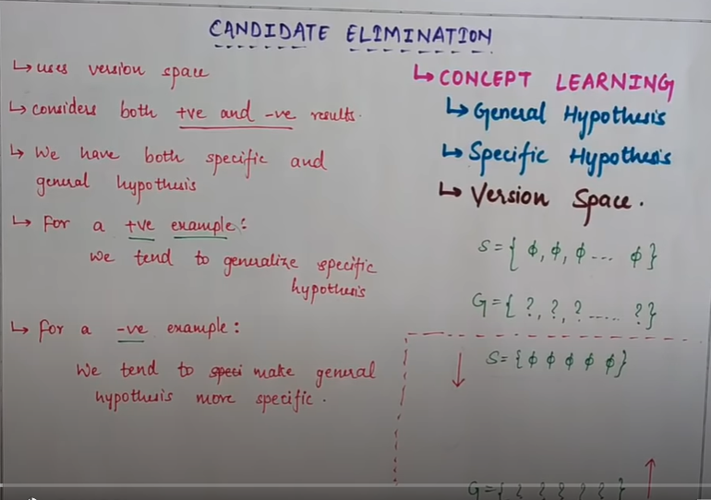

Slide 13
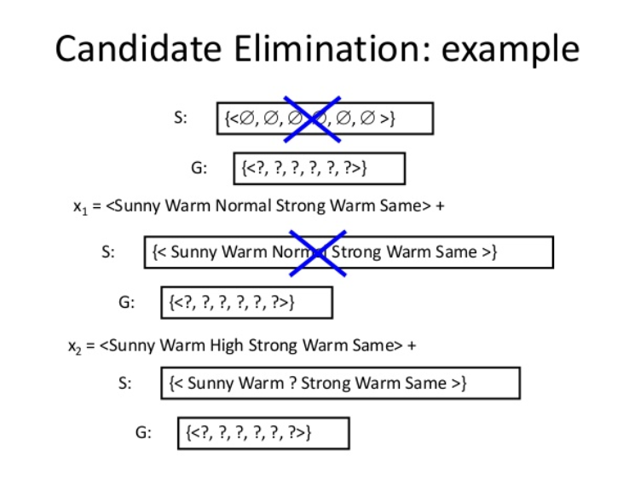
Example

Slide 14
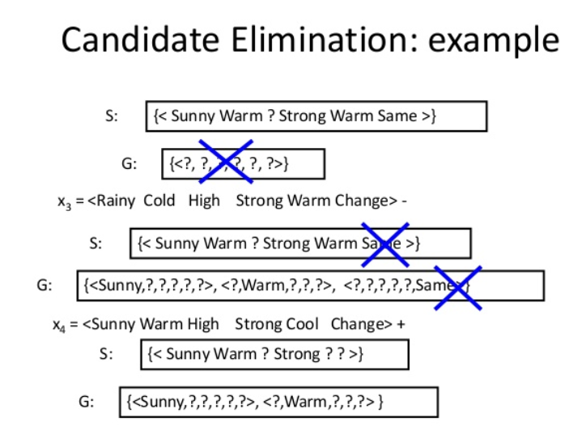
Example

Slide 15
<sunny,warm,?,strong,warm,same>
<r,c,h,s,w,c>-
<s,w,h,s,c,c>
<s,w,?,s,?,?>____s4
{<s,?,?,???>,<?,W,?????>}---G4
{<s,?,?,???>,<?,W,?????> <??????,Same>}----G3
<?, ?,?, ?,?, ?,?>

Slide 16
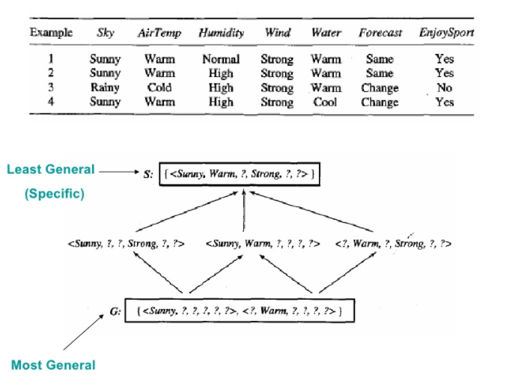
Example

Slide 17
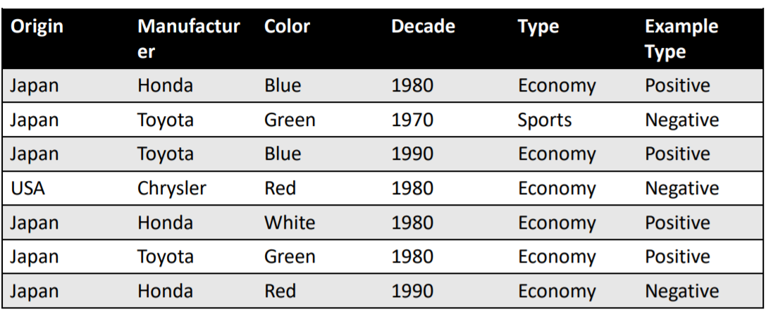
Try!!

Slide 18
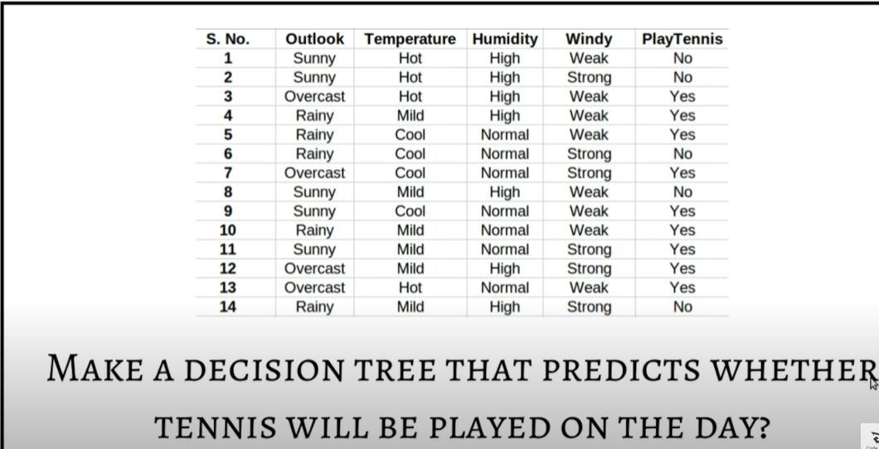
Program 3
Write a program to demonstrate the working of the decision tree based ID3 algorithm. Use an appropriate data set for building the decision tree and apply this knowledge to classify a new sample.

Slide 19
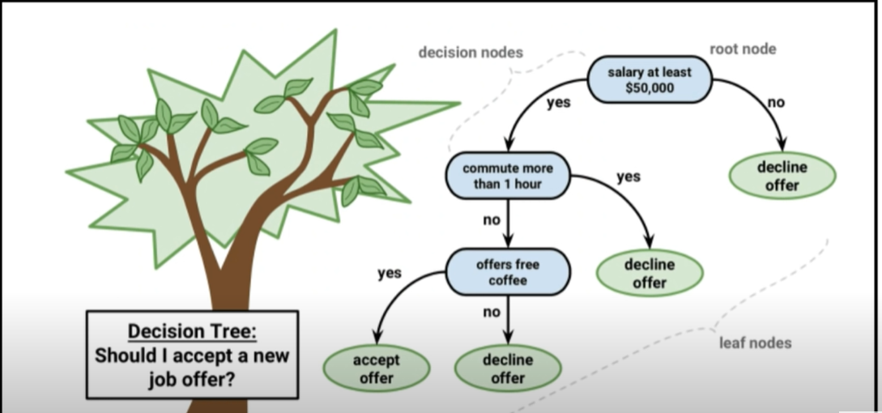
Decision Tree

Slide 20
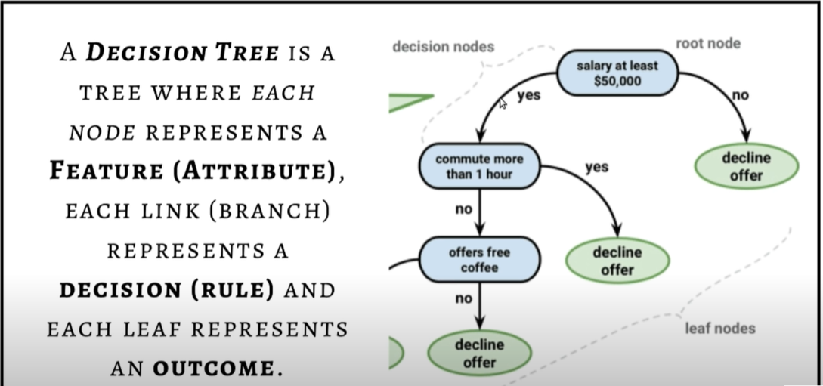

Slide 21
Decision Tree

Slide 22
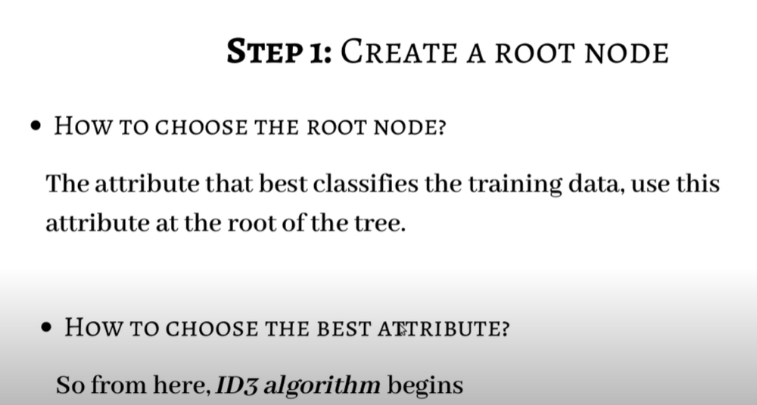
Steps for implementation

Slide 23
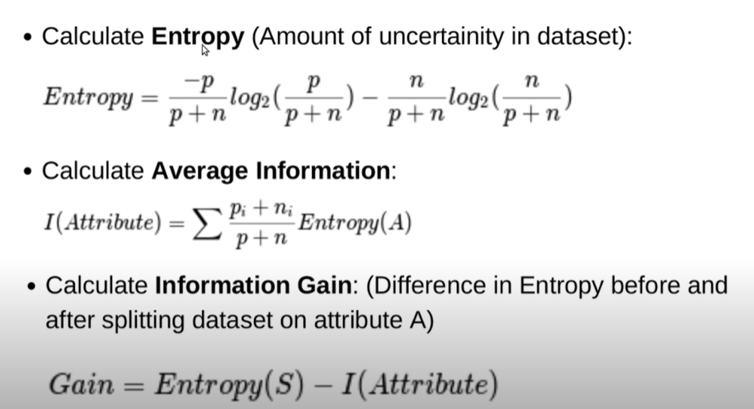
Entropy and Information Gain

Slide 24
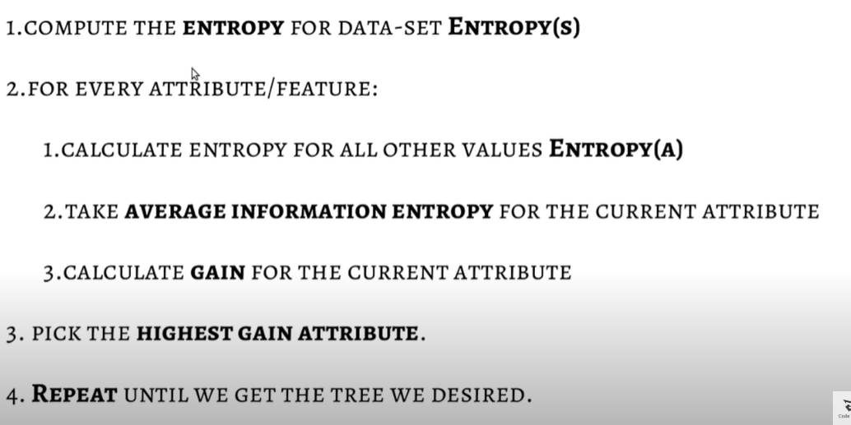
Algorithm

Slide 25
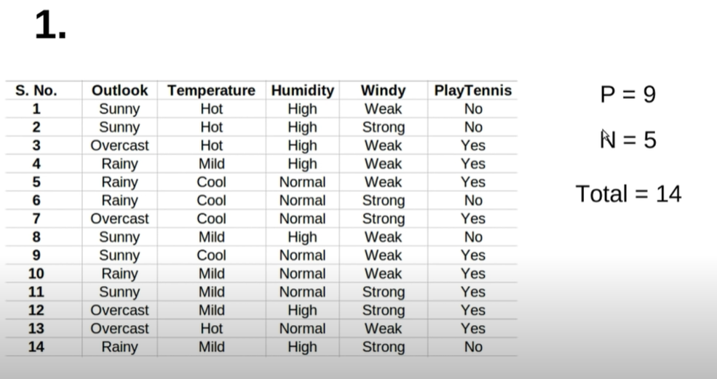
Positive and Negative

Slide 26
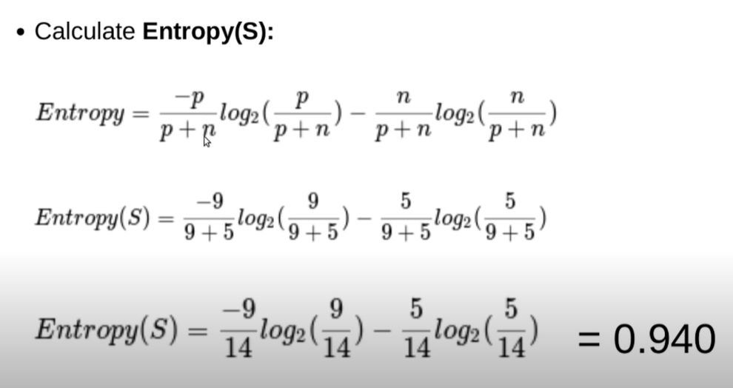
Overall Entropy

Slide 27
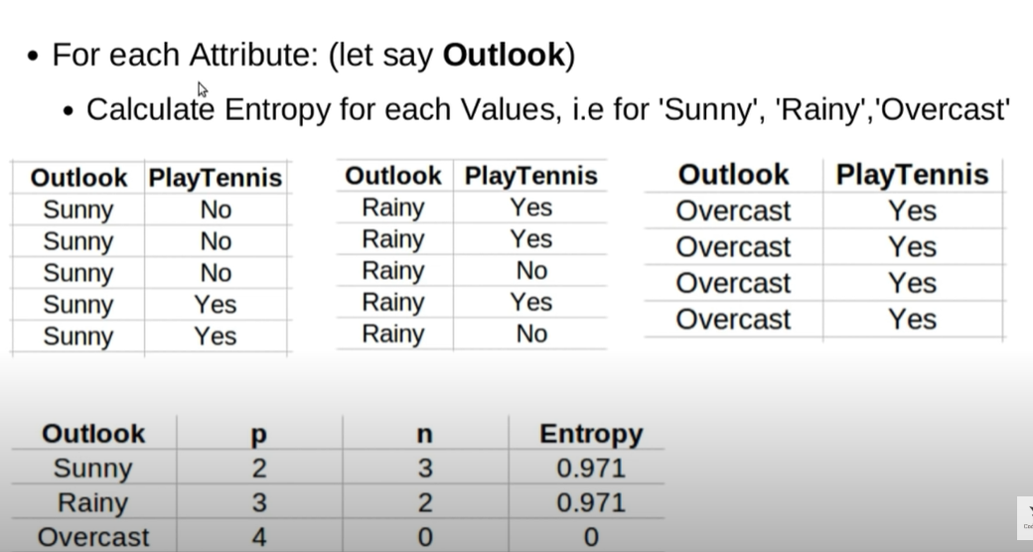
Outlook:

Slide 28
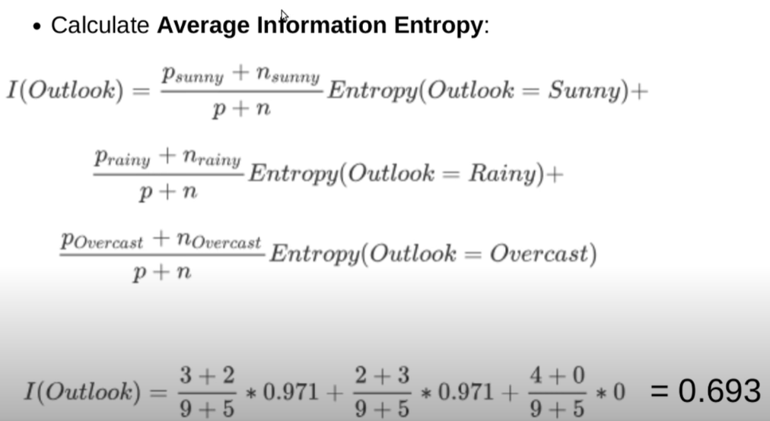
Information of Outlook:

Slide 29
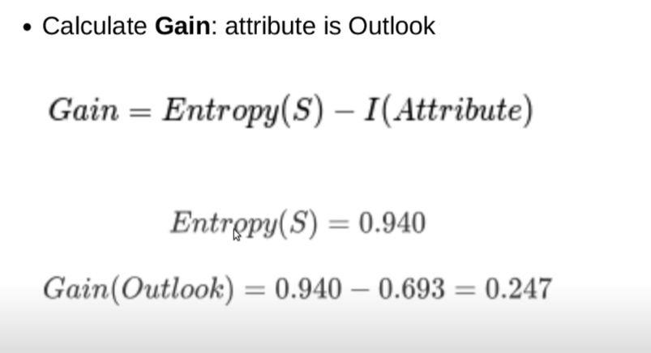
Gain:Outlook

Slide 30
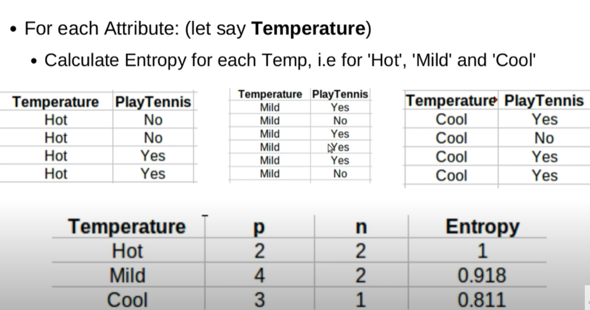
Attribute: Temperature

Slide 31
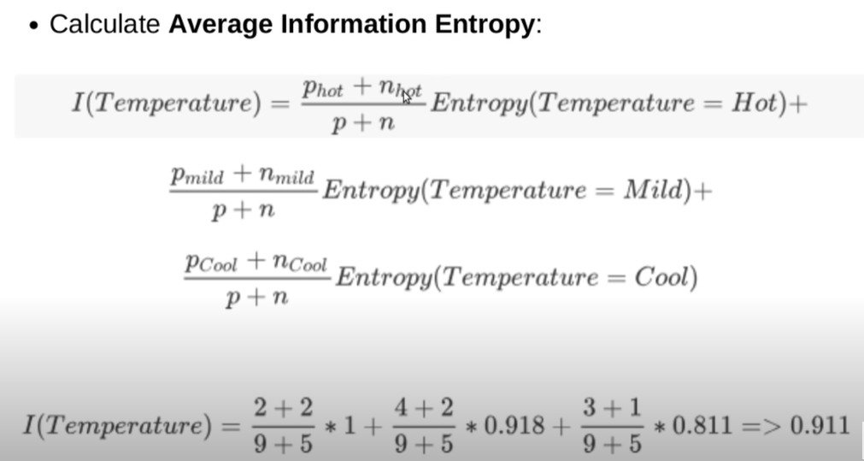
Information of Temperature

Slide 32
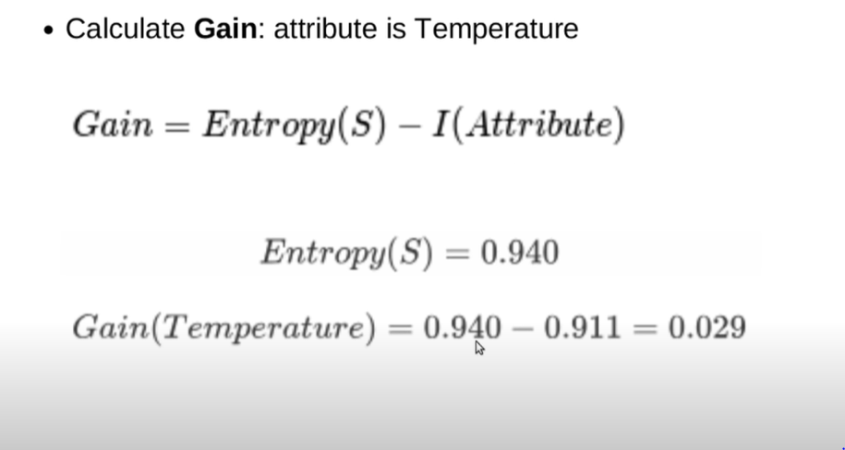
Gain:Temperature

Slide 33
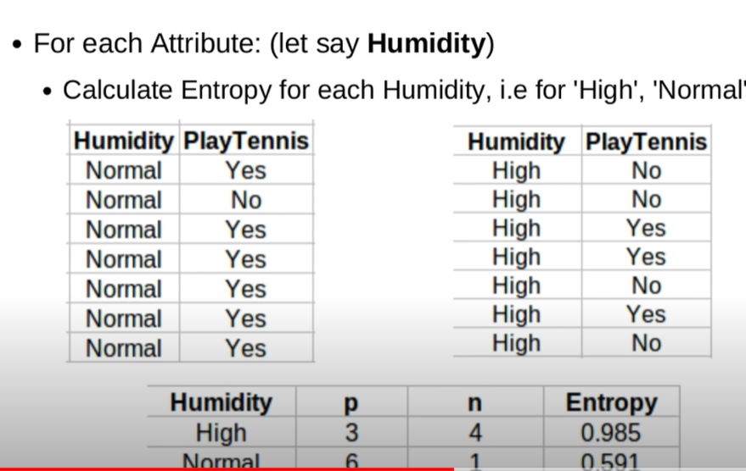
Attribute:Humidity

Slide 34
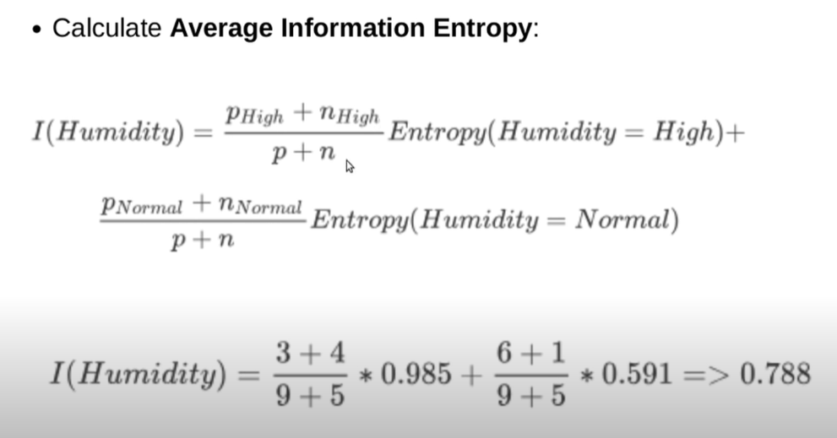
Information of Humidity

Slide 35
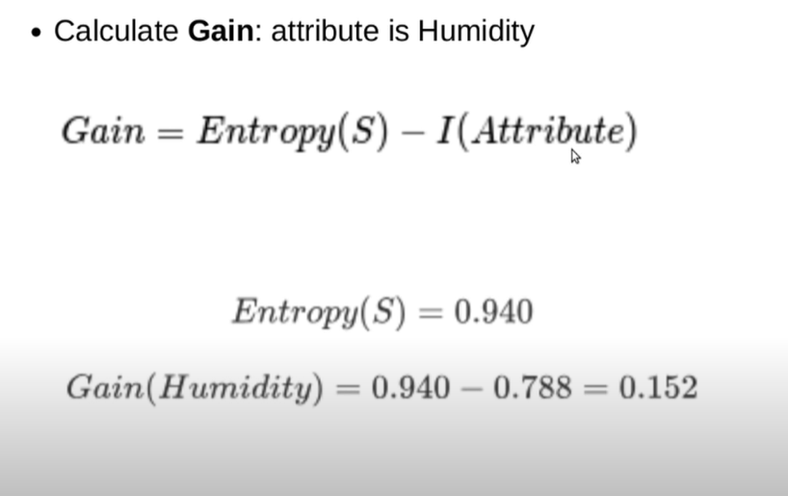
Gain:Humidity

Slide 36
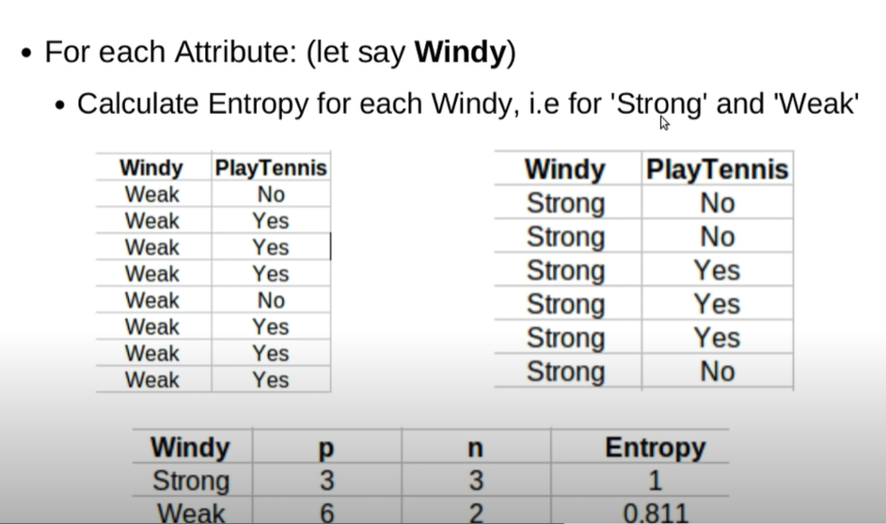
Attribute: Windy

Slide 37
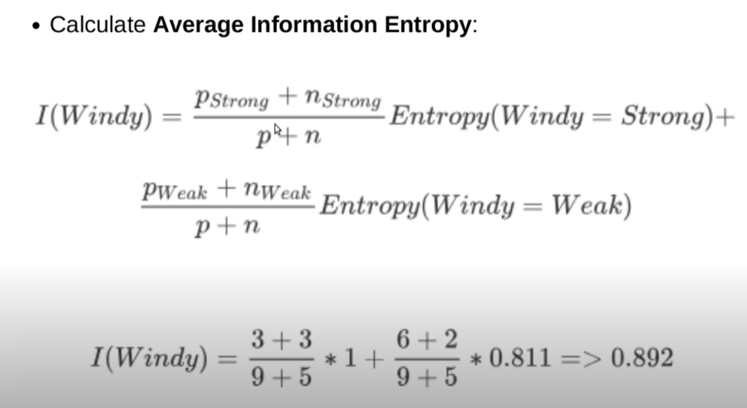
Information of windy

Slide 38
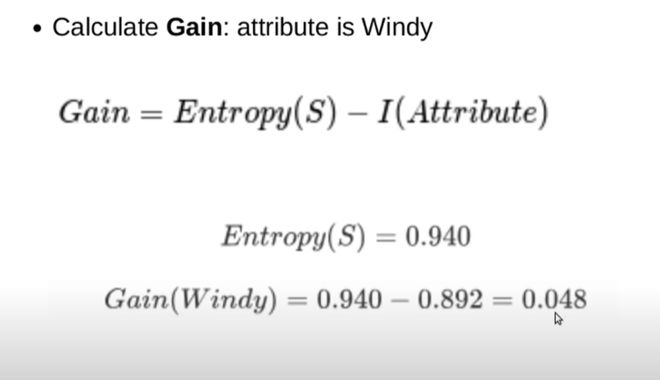
Gain: Windy

Slide 39
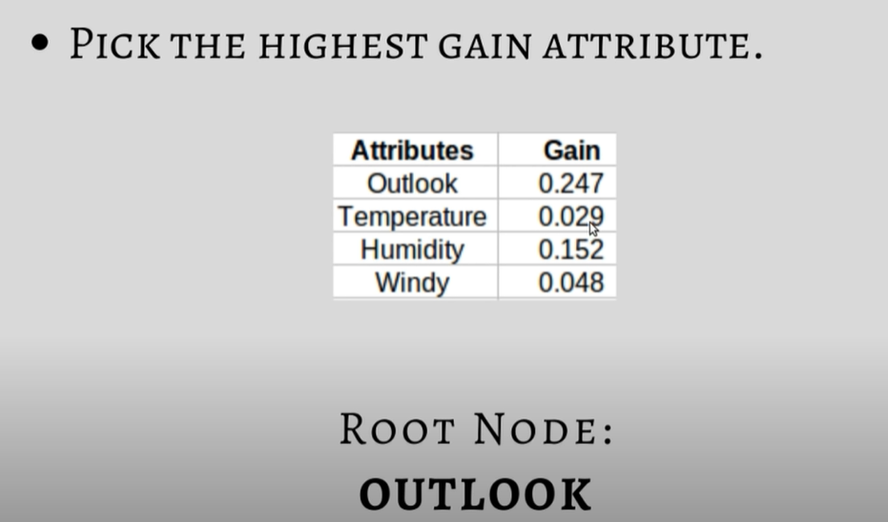
ROOT NODE: OUTLOOK

Slide 40
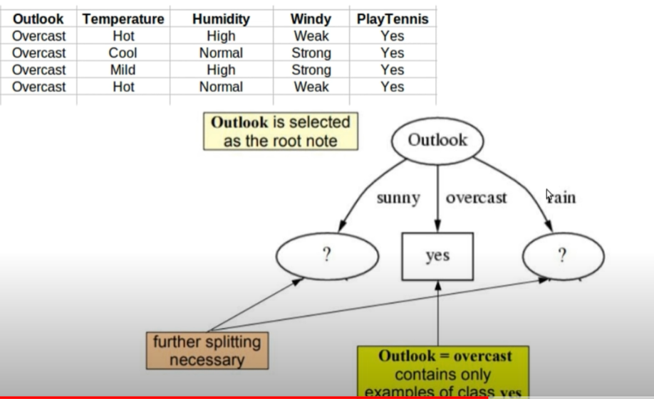
Decision Tree with Root Node

Slide 41
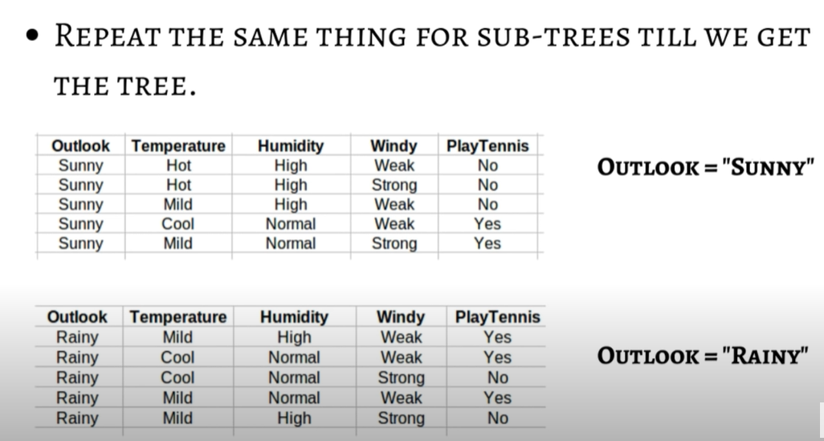
SUBTREE:

Slide 42
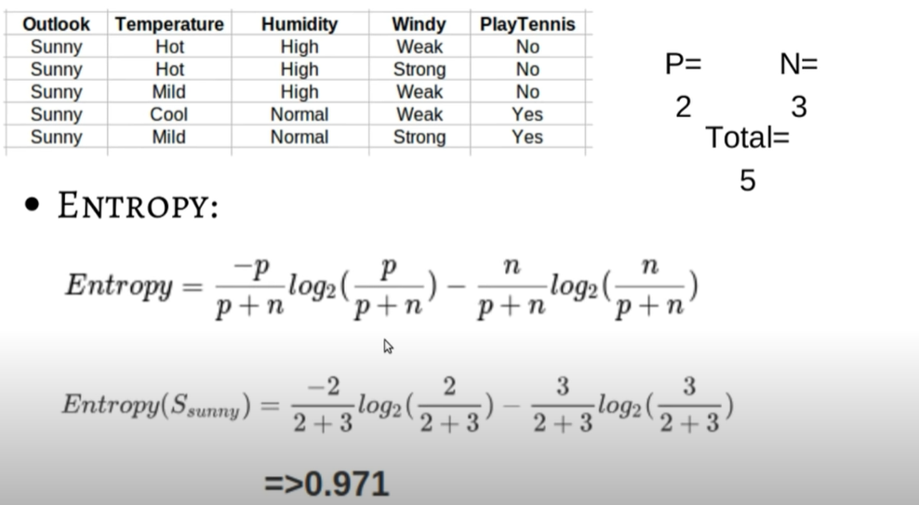
Entropy: Outlook(Sunny)

Slide 43
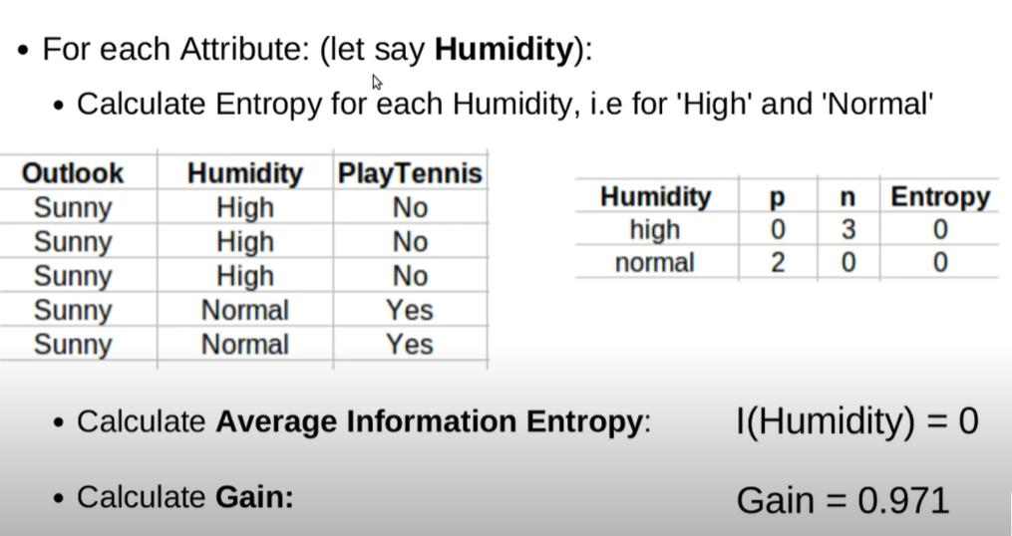
Sunny with Humidity

Slide 44
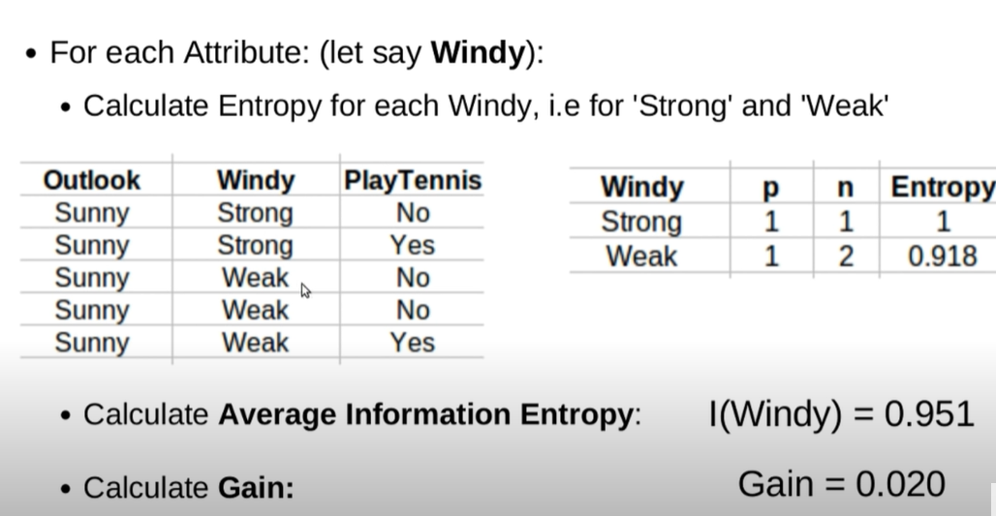
Sunny with Windy

Slide 45
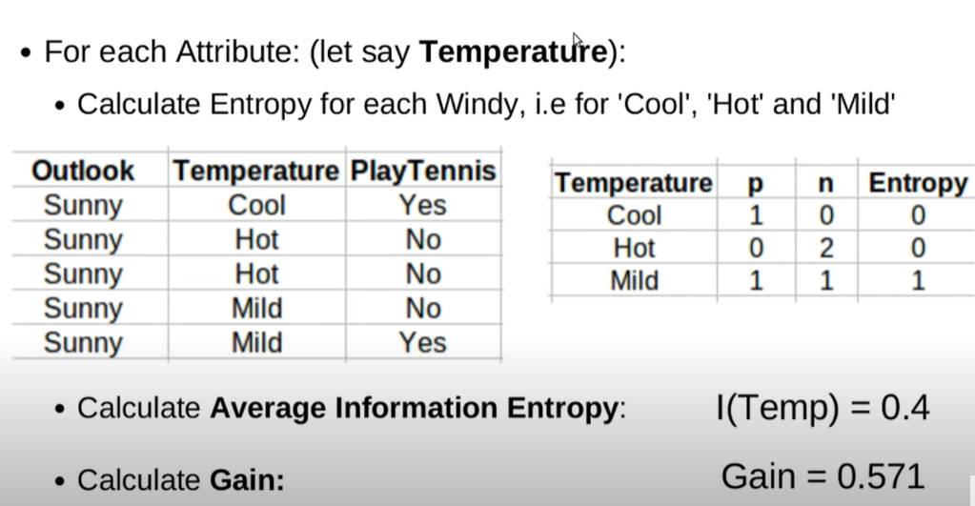
Sunny with Temperature

Slide 46
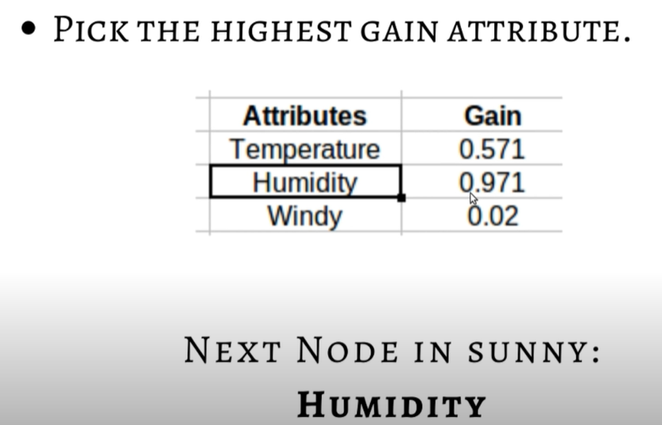
Subtree node in Sunny:

Slide 47
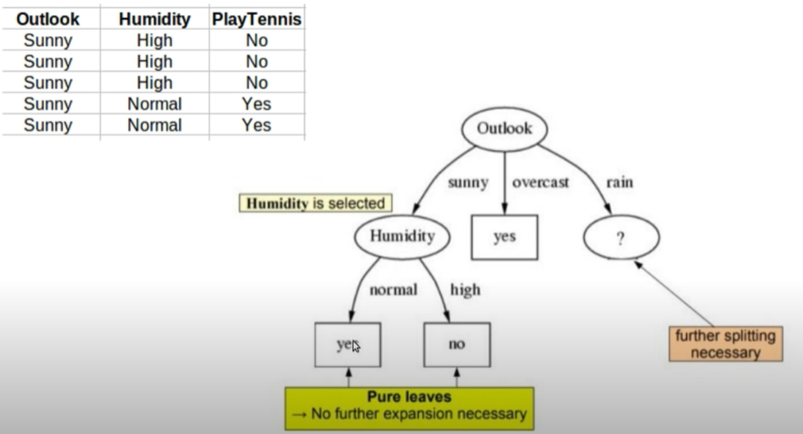
Decision Tree Outlook-Sunny-Humidity

Slide 48
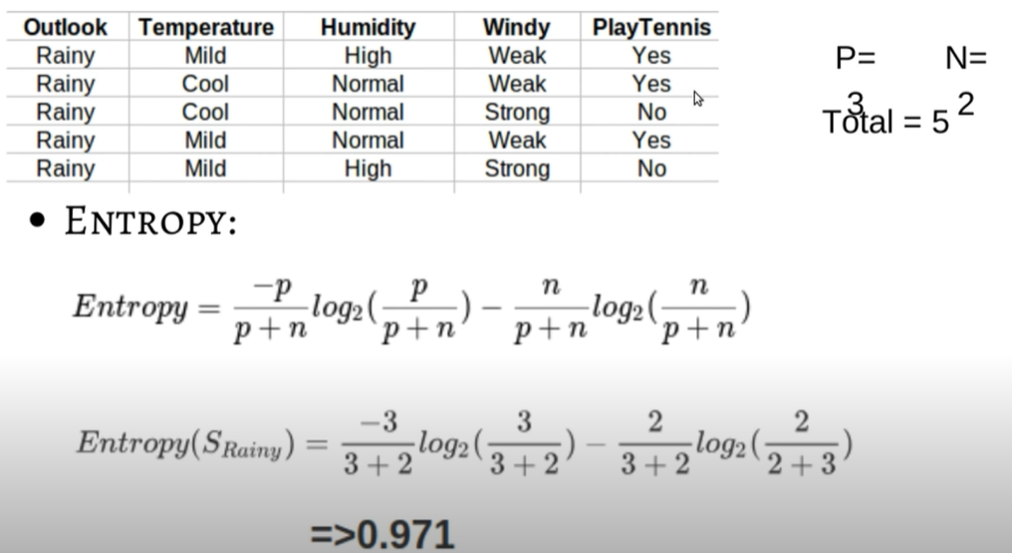
Entropy Outlook(Rainy)

Slide 49
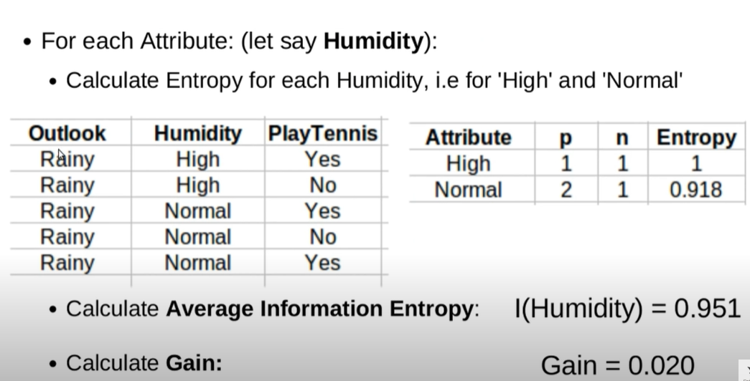
Rainy with Humidity

Slide 50
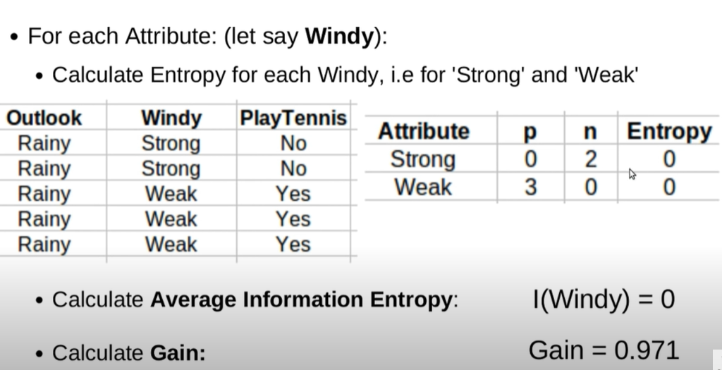
Rainy with windy

Slide 51
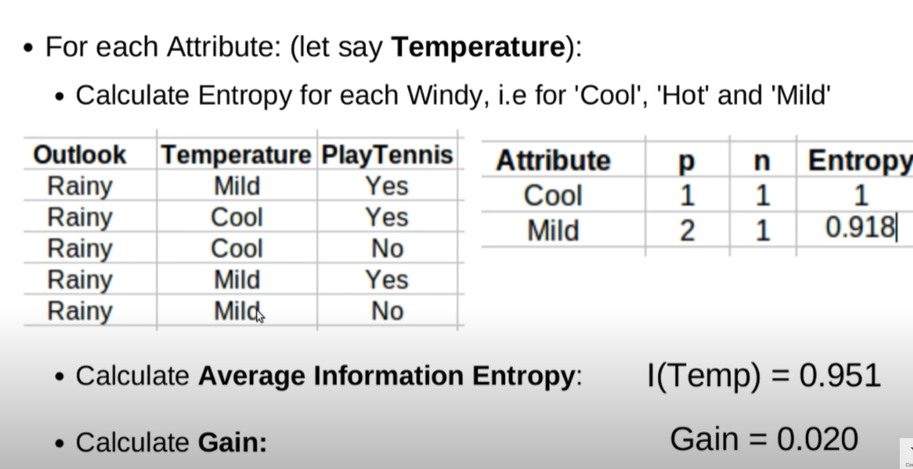
Rainy with Temperature

Slide 52
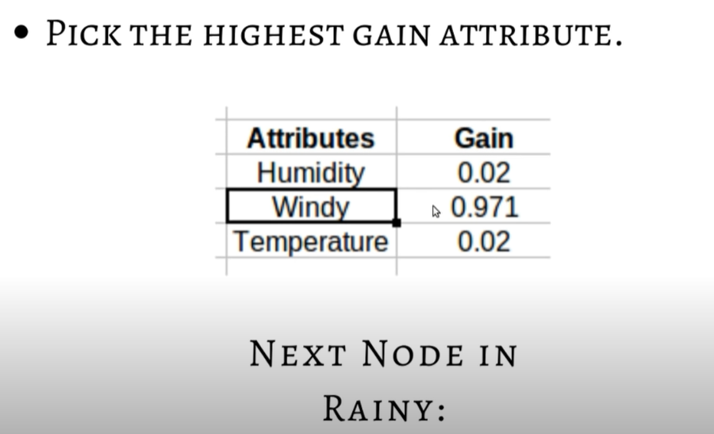
Subtree node in Rainy
WINDY

Slide 53
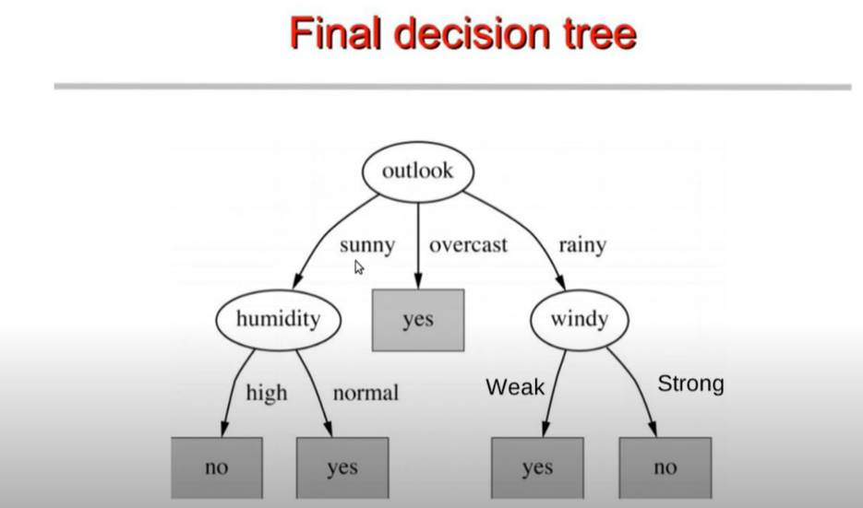

Slide 54
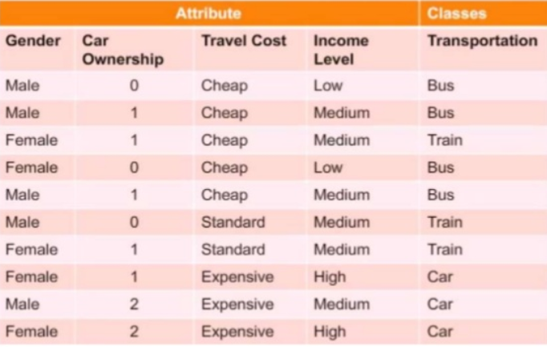
TRY!!!

Slide 55

Program 4
Build an Artificial Neural Network by implementing the Backpropagation algorithm and test the same using appropriate data sets.

Slide 56

Back Propagation y=w*x, h1=i1*w1+i2*w2

Slide 57
i/p Desired o/p
0 0
1 2
2 4
Weight=3,4,5,2 model o/p=w*x
i/p | Model op | Error
0 | 0,0,0,0 | 0,0,0,0
1 | 3,4,5,2 | 1,2,3,0
2 | 6,8,10,4 | 2,4,6,0

Slide 58

Back Propagation h1=2*.11+3*.21

Slide 59

Back Propagation

Slide 60

Back Propagation

Slide 61

Back Propagation

Slide 62

Back Propagation

Slide 63

Back Propagation

Slide 64

Back Propagation 02=

Slide 65

Back Propagation

Slide 66

Back Propagation

Slide 67

Back Propagation

Slide 68

Back Propagation

Slide 69

Back Propagation

Slide 70
Delta out o1/del net 01
Del out o1=1/1+e^-neto1
1/1+e^-x=f(x)(1-f(x))=out1(1-out1)=0.75(1-0.75)= 0.186

Slide 71

Back Propagation

Slide 72

Back Propagation

Slide 73

Back Propagation

Slide 74

Back Propagation

Slide 75

Back Propagation

Slide 76

Back Propagation

Slide 77

Back Propagation

Slide 78

Back Propagation

Slide 79

Back Propagation

Slide 80
[2/3 9/9
1/3 5/9
3/3 6/9]

Slide 81
Program 5 & 6
Write a program to implement the naïve Bayesian classifier for a sample training data set stored as a .CSV file. Compute the accuracy of the classifier, considering few test data sets.
Assuming a set of documents that need to be classified, use the naïve Bayesian Classifier model to perform this task. Built-in Java classes/API can be used to write the program. Calculate the accuracy, precision, and recall for your data set.

Slide 82

Naïve Bayes classifier to classify text

Slide 83

Naïve Bayes

Slide 84

Example

Slide 85

Calculating Probabilities

Slide 86

Steps

Slide 87

Example

Slide 88

Workflow

Slide 89

Word count

Slide 90

Contd.,

Slide 91

Term Frequency

Slide 92

Contd.,

Slide 93


Slide 94

Naïve Bayes Model

Slide 95

Prediction

Slide 96

Micro Average

Slide 97

Macro Average

Slide 98

Weighted Average

Slide 99
Program 7
Write a program to construct a Bayesian network considering medical data. Use this model to demonstrate the diagnosis of heart patients using standard Heart Disease Data Set. You can use Java/Python ML library classes/API.

Slide 100
Bayesian networks
Bayesian networks have been the most important contribution to the field of AI in the last 10 years
Provide a way to represent knowledge in an uncertain domain and a way to reason about this knowledge
Many applications: medicine, factories, help desks, spam filtering, etc.

Slide 101

P(x|Y,Z)

Slide 102
Program 9
Write a program to implement k-Nearest Neighbour algorithm to classify the iris data set. Print both correct and wrong predictions. Java/Python ML library classes can be used for this problem.

Slide 103

k-Nearest Neighbor(kNN)

Slide 104

kNN
k-Nearest Neighbor is a lazy learning algorithm which stores all instances correspond to training data points in n-dimensional space.
When an unknown discrete data is received, it analyzes the closest k number of instances saved (nearest neighbors)and returns the most common class as the prediction and for real-valued data it returns the mean of k nearest neighbors.
In the distance-weighted nearest neighbor algorithm, it weights the contribution of each of the k neighbors according to their distance using the following query giving greater weight to the closest neighbors.
Distance calculating query

Slide 105
kNN Algorithm
The KNN Algorithm
1. Load the data
2. Initialize K to your chosen number of neighbors
3. For each example in the data
3.1 Calculate the distance between the query example and the current example from the data.
3.2 Add the distance and the index of the example to an ordered collection
4. Sort the ordered collection of distances and indices from smallest to largest (in ascending order) by the distances
5. Pick the first K entries from the sorted collection
6. Get the labels of the selected K entries
7. If regression, return the mean of the K labels
8. If classification, return the mode of the K labels

Slide 106
Example
Name | Age | Gender | Sport
Ajay | 32 | M | Football
Salman | 40 | M | Neither
Kavi | 16 | F | Cricket
Keerthi | 34 | F | Cricket
Arun | 55 | M | Neither
Sachin | 40 | M | Cricket
Kareena | 20 | F | Neither
Rahul | 15 | M | Cricket
Deepika | 55 | F | Football
Shewag | 15 | M | Football
Aishwarya | 5 | F | ??

Slide 107

Solution
Choose k=3
Calculate the distance between the query and the training data using distance equation like Euclidean, Manhattan or Minkowski
dist=$\sqrt{{\left(x2−x1\right)}^{2}}{\overline{+\left(y_{2}−y_{1}\right)}}^{2}$
=$\sqrt{{\left(32−5\right)}^{2}+\left(0−1\right)2}$
3.Add the distance value into the collection.
4.Sort the distance in ascending order.
5.Choose the neighbors based on k
6.Classify the query.

Slide 108


Slide 109
Contd.,
After sorting, the first three distance value are:
Keerthi - 9.00 -Cricket
Rahul - 10.00 - Cricket
Shewag - 10.05 - Football
But, why 3 values????????
Aishwarya will be classified to the group CRICKET

Slide 110
Pros and Cons of KNN
Pros
It is very simple algorithm to understand and interpret.
It is very useful for nonlinear data because there is no assumption about data in this algorithm.
It is a versatile algorithm as we can use it for classification as well as regression.
It has relatively high accuracy but there are much better supervised learning models than KNN.
Cons
It is computationally a bit expensive algorithm because it stores all the training data.
High memory storage required as compared to other supervised learning algorithms.
Prediction is slow in case of big N.
It is very sensitive to the scale of data as well as irrelevant features.

Slide 111

Evaluation metrics in classification

Slide 112

Metrics
1.Accuracy
Accuracy = (TP+TN)/(TP+FP+FN+TN)
2.Precision
Precision = (TP)/(TP+FP)
3.Recall
Recall = (TP)/(TP+FN)
4.F1 Score

Slide 113
Program 8
Apply EM algorithm to cluster a set of data stored in a .CSV file. Use the same data set for clustering using k-Means algorithm. Compare the results of these two algorithms and comment on the quality of clustering. You can add Java/Python ML library classes/API in the program.

Slide 114


Slide 115


Slide 116
Mixtures of Gaussians
K-means algorithm
Assigned each example to exactly one cluster
What if clusters are overlapping?
Hard to tell which cluster is right
Maybe we should try to remain uncertain
Used Euclidean distance
What if cluster has a non-circular shape?
Gaussian mixture models
Clusters modeled as Gaussians
Not just by their mean
EM algorithm: assign data to cluster with some probability

Slide 117
Program 10
Implement the non-parametric Locally Weighted Regression algorithm in order to fit data points. Select appropriate data set for your experiment and draw graphs.

Slide 118


Slide 119


Slide 120


Slide 121


Slide 122


Slide 123


Slide 124


